Slide 1
Reading Bluetooth LE Services
Robert Makatura

Slide 2
What is Bluetooth LE?
Bluetooth LE is a standard for Low Energy IOT Devices.
Contrary to normal bluetooth, the device connecting doesn’t maintain a constant high-bandwidth connection.
Notification services are used by many sensors, like heart rate monitors
Bluetooth advertisements are used by ‘beacons’.
AirDrop uses beacons to transmit personal wifi information to initiate the service
Bluetooth LE can also be used to write messages to displays, for transactions, and more.

Slide 3
How are services organized?
Once a device is connected through Bluetooth, the “server” sends bluetooth gatt (generic attribute) profiles to the client
The client selects attributes and sends bytes telling the server the type of connection it would like to have
A typical connection would look like: Server tells device the profiles it has, device writes on the notification channel “0100” for notifications
GATT Profiles are standardized by the bluetooth SIG, but many are proprietary (like AirDrop)
Each profile is marked by a particular UUID (128 bits), with individual handles under the profile taking up the first 8 characters

Slide 4
Example of a connection- log of NRFConnect
NRFConnect is an Android app that can read and log all the bluetooth connections on your device.
It operates automatically to connect with devices you select on the app, but it can also read data being sent to wearables and other devices other apps are connected to.
https://raw.githubusercontent.com/robmak3/Schwinn-IC4-Scripts/main/Log%202020-12-28%2020_42_31.txt
In this demo, you will see many unique UUIDs, attributes, and profiles that the device connects to.

Slide 5
Linux Bluetooth Driver - Bluez
Can be interacted through DBus, which is a linux protocol for application and driver communication.
Can also be ran on the bluetoothctl command on the terminal

Slide 6
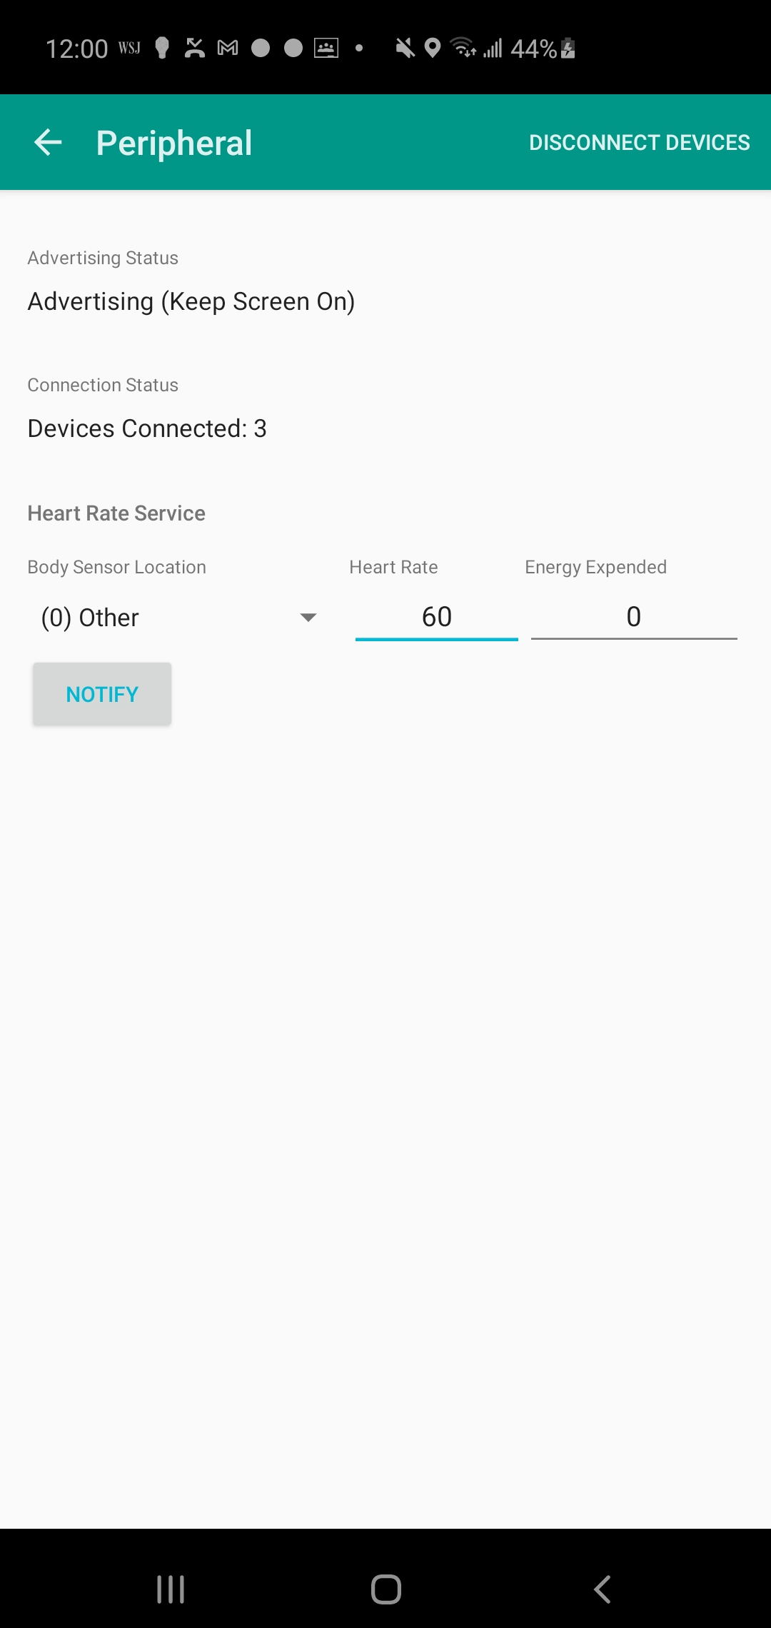
Example of a Bluetooth Heart Rate Service
(Demo for the class)
Using the Android app “Bluetooth Peripheral Simulator”, I will show you how you can connect to a bluetooth device in the terminal.
Start with opening the app and running sudo bluetoothctl on the command line

Slide 7
Bluetoothctl- useful commands
Scan on- discover devices
connect/disconnect
Menu gatt- allows you to probe gatt profiles
list-attributes/select-attribute - allows you to probe services and their characteristics
select-attribute 00002a37-0000-1000-8000-00805f9b34fb - controls notifications for Heart Rate Monitor
Acquire-notify- sends bytes to start receiving notifications onto the attribute.
On some profiles this may have to be done manually, by writing “0100” or “0300” onto the handle though the write command.

Slide 8
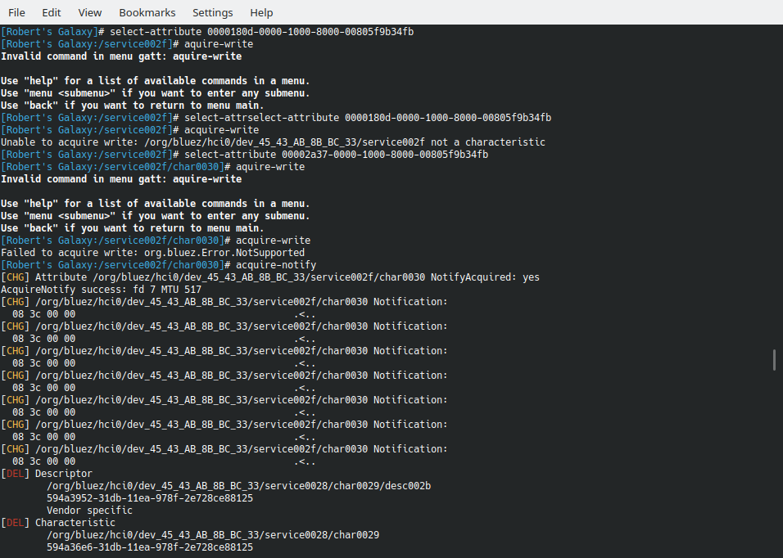
Notifications!
When I click “notify” on the app, it sends notifications.
Different gatt profiles have different ways of encoding data, important to understanding when dealing with decimals.
For this one, 08-3c = 60 in hexadecimal, or 60 bpm.

Slide 9
Reading Notifications From Python
Complicated code or simple code? A lot can go wrong!
The DBus protocol is interacted with to initiate the notifications on the bluez driver, replacing the terminal
The File Descriptor for the bluez file is opened to read the notifications
Required python modules: pydbus (on pip), os, time, sys
To run the python script, sudo -E must be used to maintain the proper environment
Only works on linux!

Slide 10
Before you start!
You need to know your device MAC address, and android doesn’t make it easy, depending on the device.
Sudo bluetooth ctl and scan on can help you discover the mac address, but two devices may show up. One of them governs audio and other connections, and the other is the BLE Simulator app!
The BLE simulator may change whenever you disconnect, so be sure to go back often! If there is an error, you may need to run sudo bluetoothctl and then disconnect.
If your dbus isn’t easily accessible, this program will not work. I ran it on ubuntu and used d-feet for configuration, this may help you out.

Slide 11
Running the program (will be done in the demo in class)

Slide 12
Bluetooth Conclusions:
Bluetooth LE is everywhere, constantly connecting on our phones, other simple technology devices, and forms critical infrastructure in the world.
Bluetooth, however annoying, is an extremely useful hacking tool, as many devices broadcast information unencrypted and publically. Your smartwatch is probably doing it right now!
There are security mechanisms, like only connecting to one device, but these can be easily gamed and you can use rebroadcasting to manipulate people.

